Slide 2
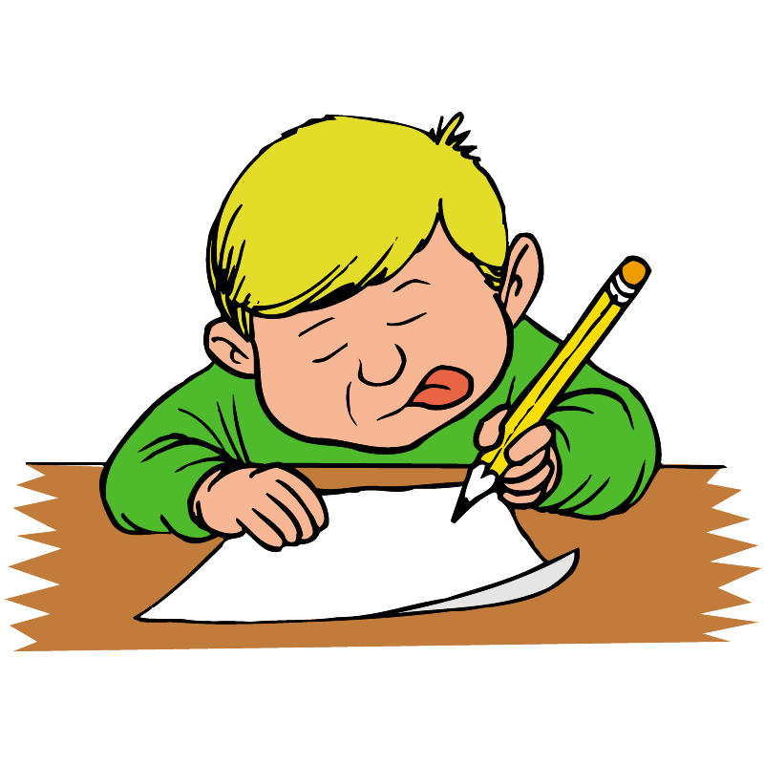
[e], [e], [e]
[pen], [pen], [pen]
[ten], [ten], [ten]
[ð], [ð], [ð]
[ðen], [ðen], [ðen]
[brʌðə], [brʌðə], [brʌðə]
When I am ten,
I'll take a pen;
Then I will write
Like brother Ben.

Slide 3
Daddy
William
Rose

Slide 4
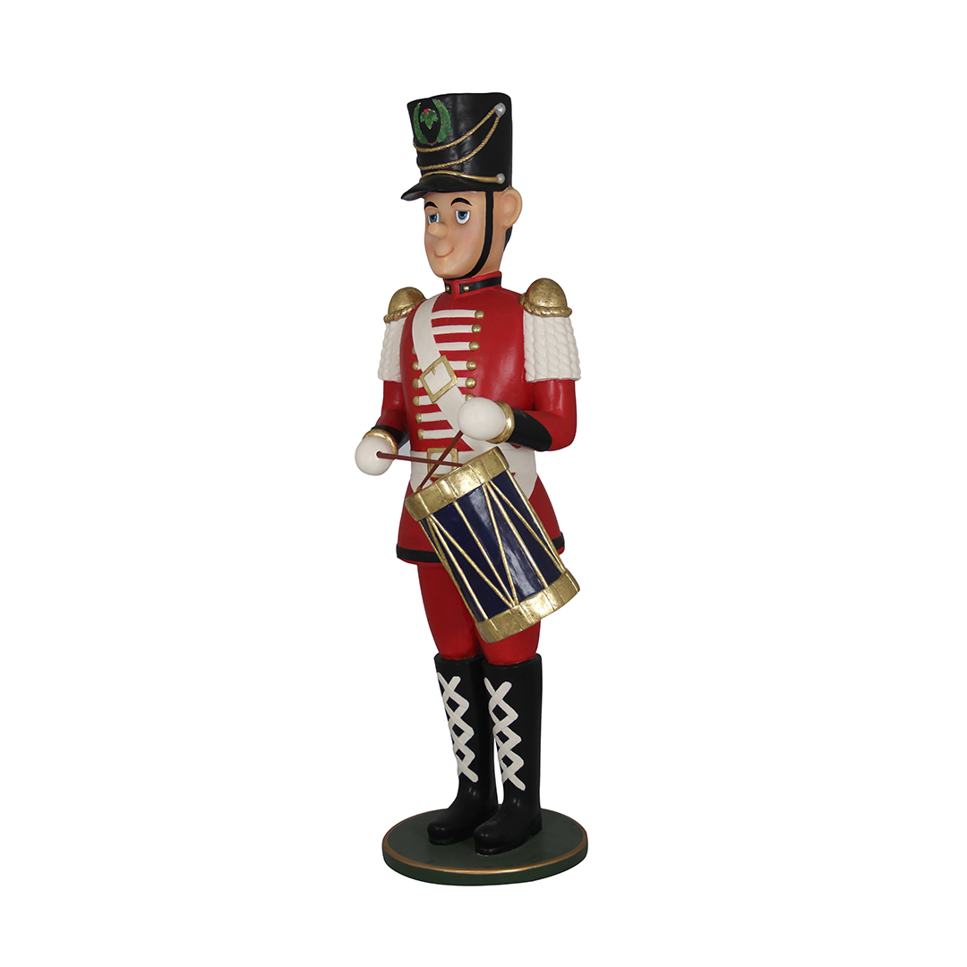
This is a toy soldier.
a toy soldier
toy soldier

Slide 5
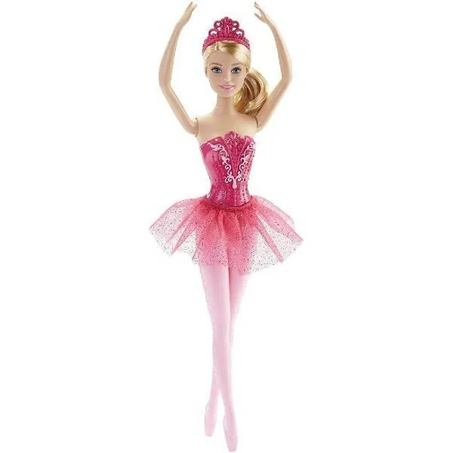
a ballerina
This is a ballerina.
ballerina
It’s a doll.

Slide 6

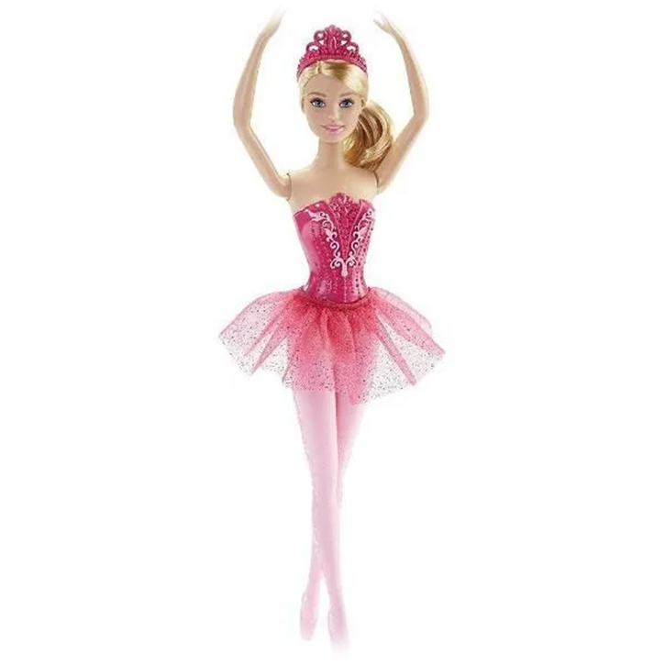
pink

Slide 7
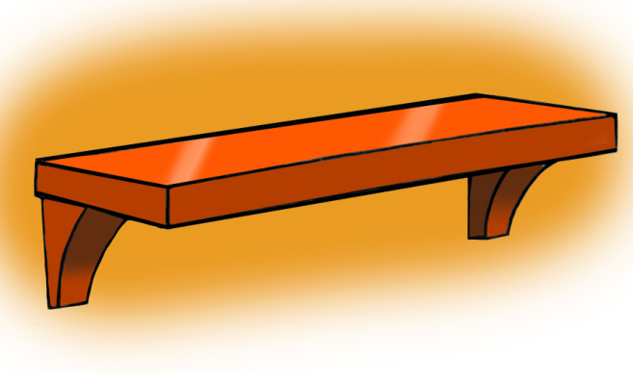
This is a shelf.
a shelf
shelf

Slide 8
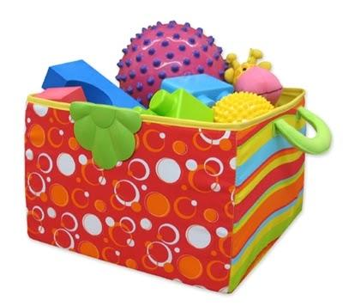
toy box
a toy box
This is a toy box.

Slide 9
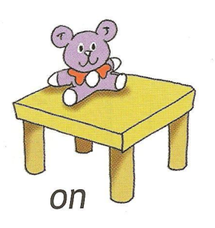
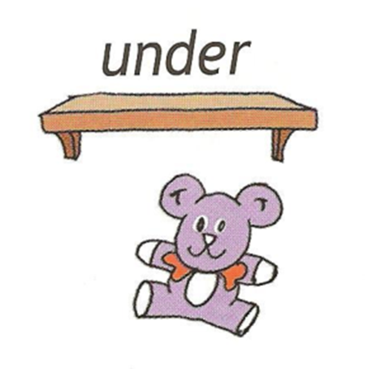
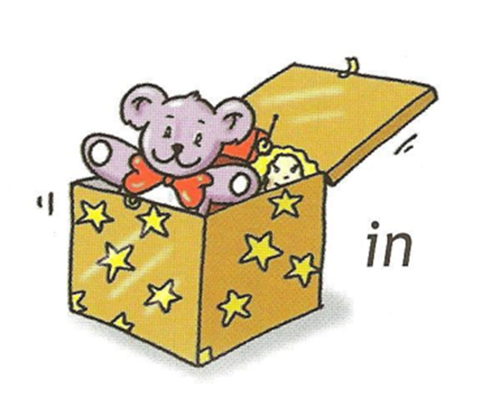

Slide 10
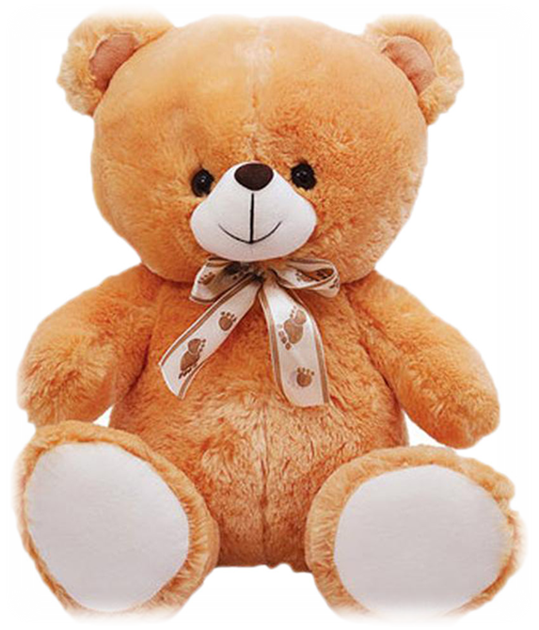
Is this a shelf?
Is this a teddy bear?
This is a teddy bear.
Is this a ballerina?

Slide 11
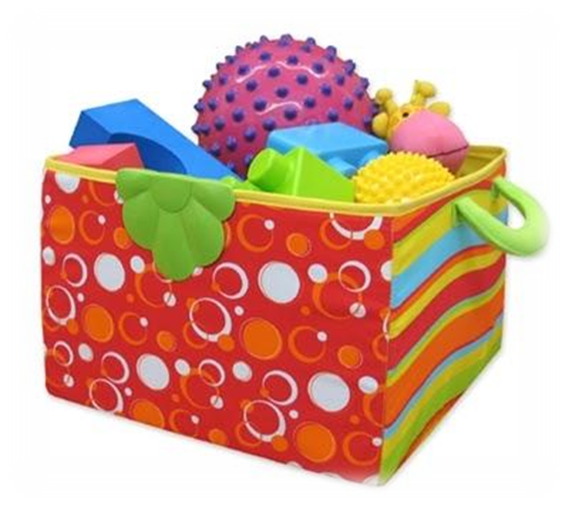
This is a toy box.
Is this a toy soldier?
Is this a toy box?

Slide 12
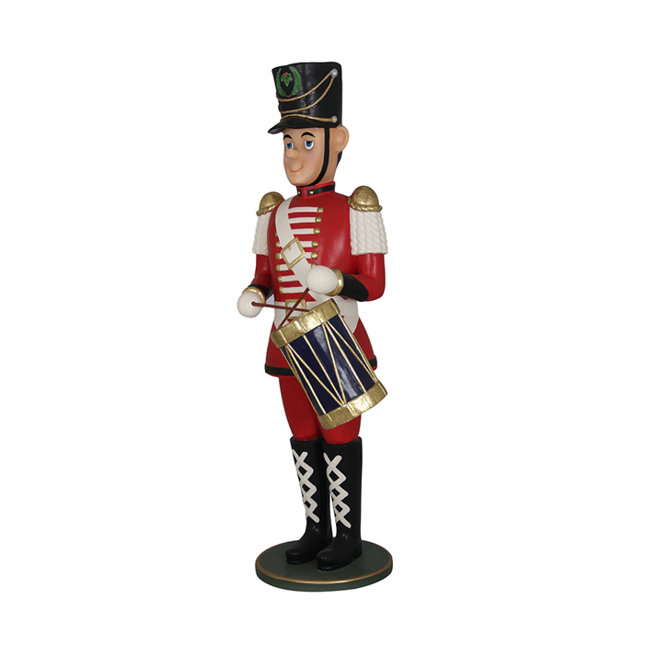
This is a toy soldier.
Is this a teddy bear?
Is this a toy soldier?

Slide 13
This is a ballerina.
Is this a ballerina?

Slide 14
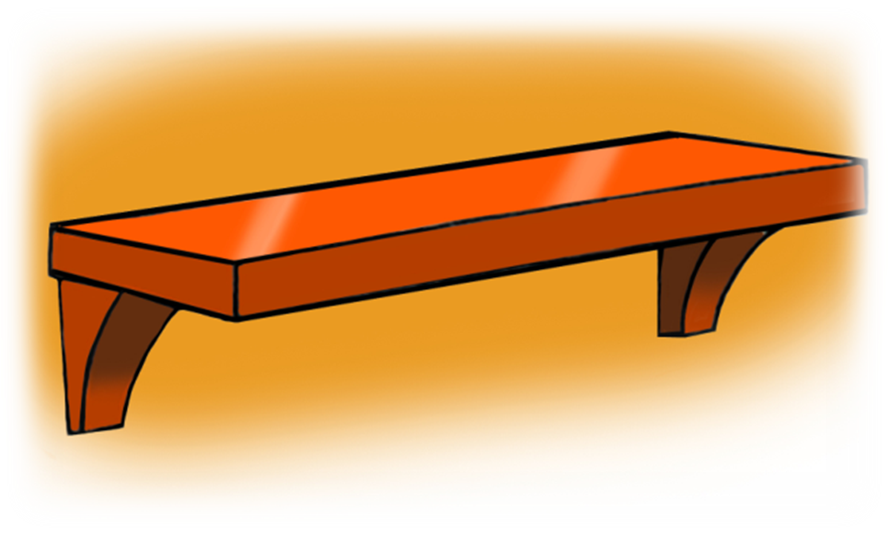
Is this a shelf?
Is this a toy box?
This is a shelf.

Slide 15
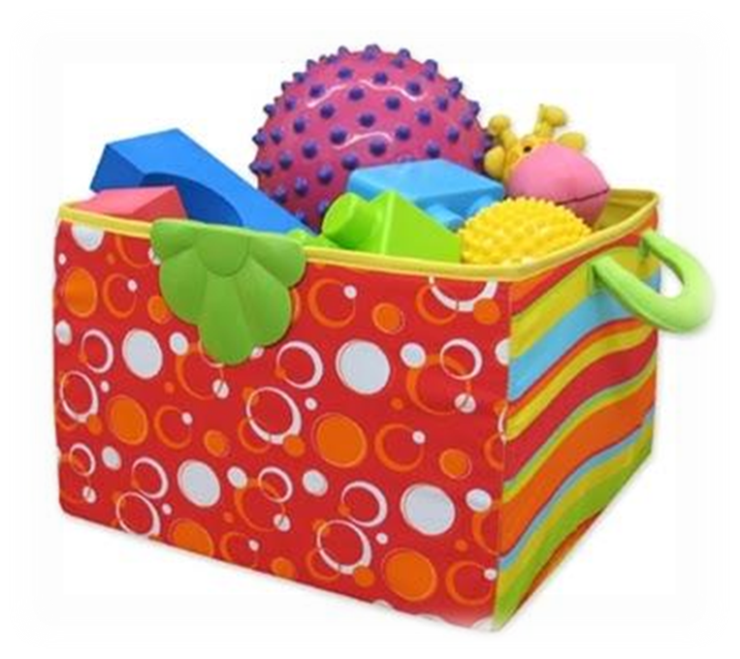
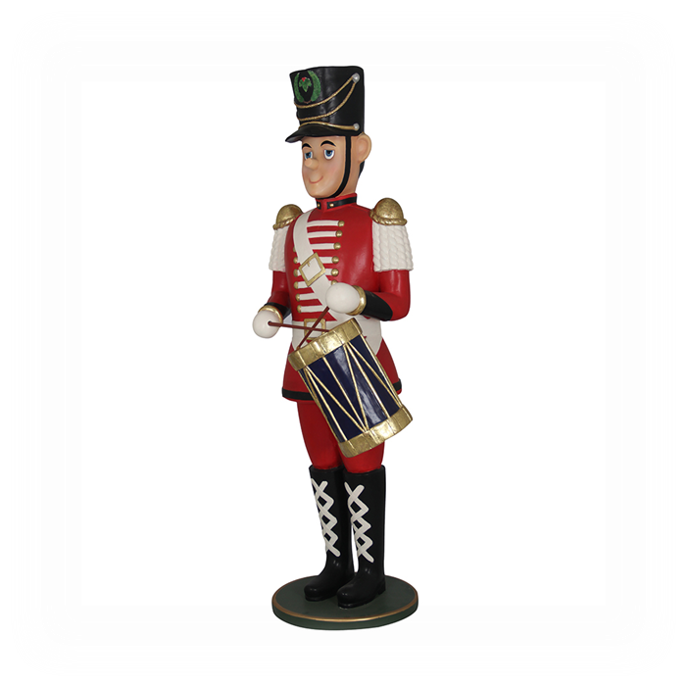



3
5
2
4
1
a toy soldier
a teddy bear
a toy box
a ballerina
a shelf
Where is ?

Slide 16
It is pink.
What colour is this?

Slide 17
on
in
under
The teddy bear is the table.

Slide 18

on
in
under
The teddy bear is the toy box.

Slide 19

under
in
on
The teddy bear is the shelf.

Slide 21
Read and say Yes or No
William has got a toy soldier.
The toy soldier has got big green eyes.
The toy soldier has got a black jacket.
The ballerina can dance on her toes.
Rose has got pretty pink shoes.
Yes
No
No
Yes
No

Slide 22

Homework

Slide 23



How do you like the lesson?
It was bad☹
It was great☺
It was good.

