Slide 1

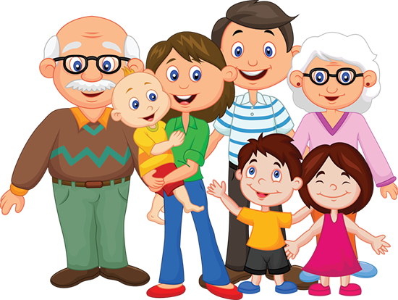
Family and Friends!
Module 1

Slide 3
What does Uncle Harry look like?
He’s tall and slim
and he’s got fair hair.
What’s he like?
He’s very funny.

Slide 4
What does Aunt Pam look like?
She’s short and slim
and she’s got dark hair.
What’s she like?
She’s very kind.

Slide 5
What does Cousin Robbie look like?
He’s tall and slim
and he’s got dark hair.
What’s he like?
He’s very friendly.

Slide 6
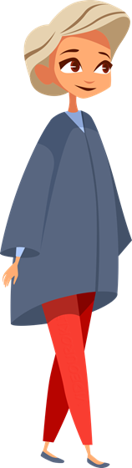
Ann
What does Ann look like?
She’s tall and slim
and she’s got fair hair.
What’s she like?
She’s very friendly.

Slide 7
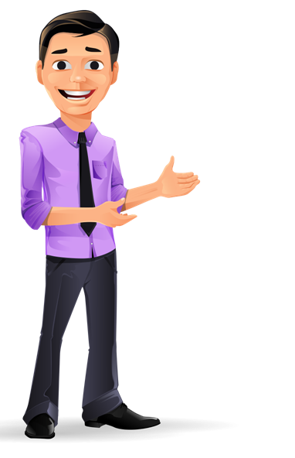
Fred
What does Fred look like?
He’s tall and slim
and he’s got dark hair.
What’s he like?
He’s very funny.

Slide 8
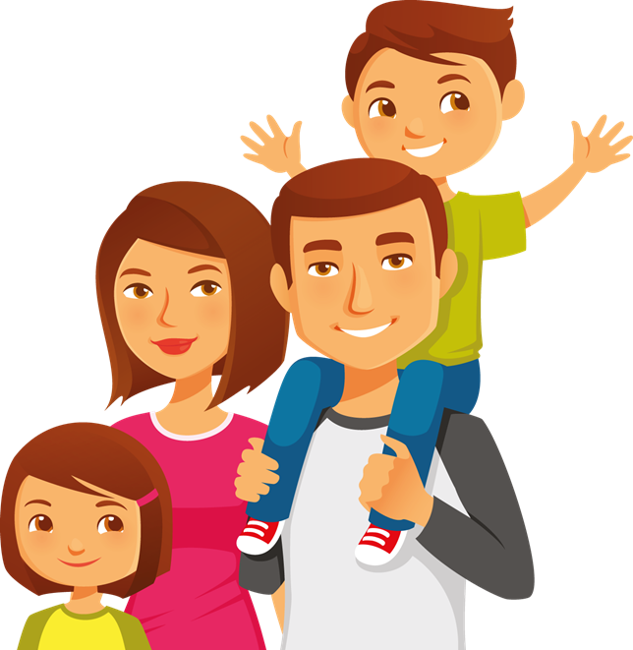
What does Mum look like?
She’s tall and slim and
she’s got brown eyes and dark hair.
What’s she like?
She’s very kind.

Slide 9
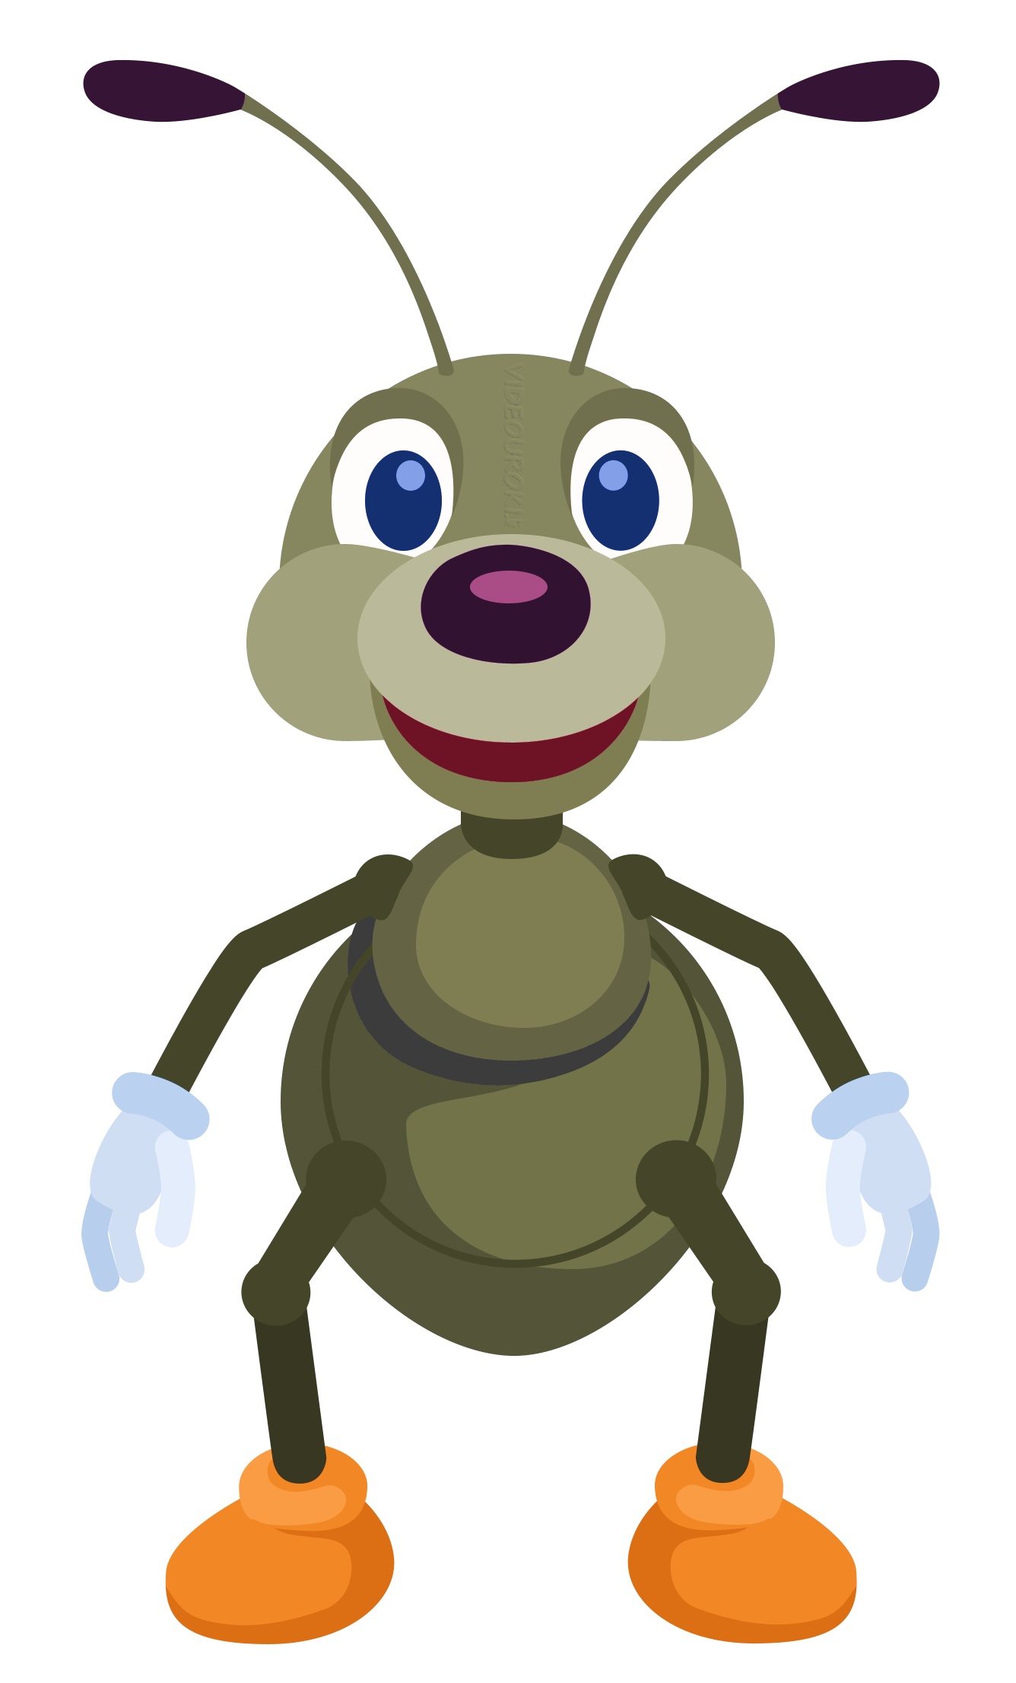
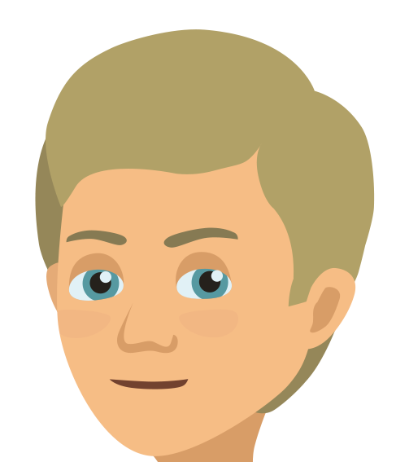
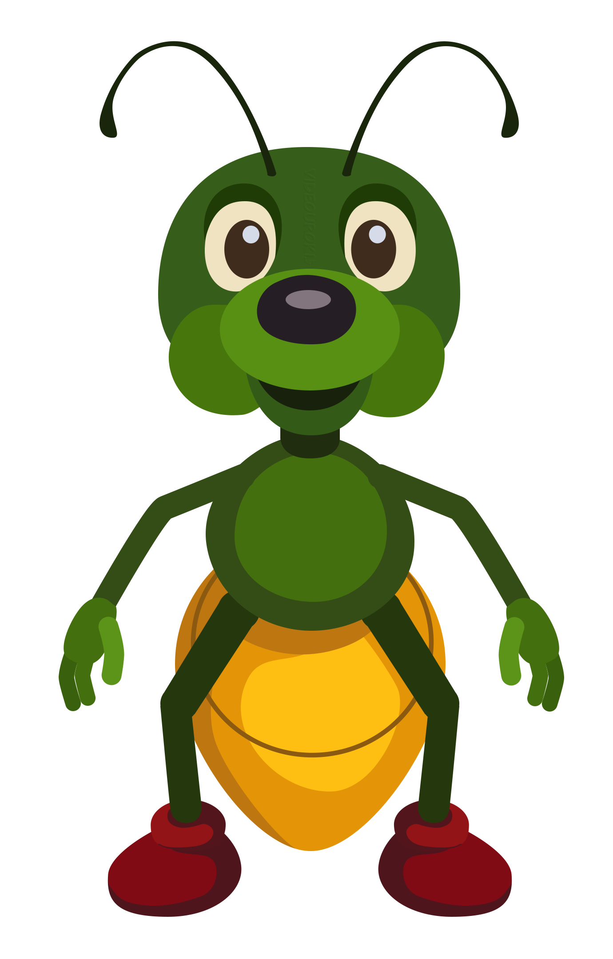
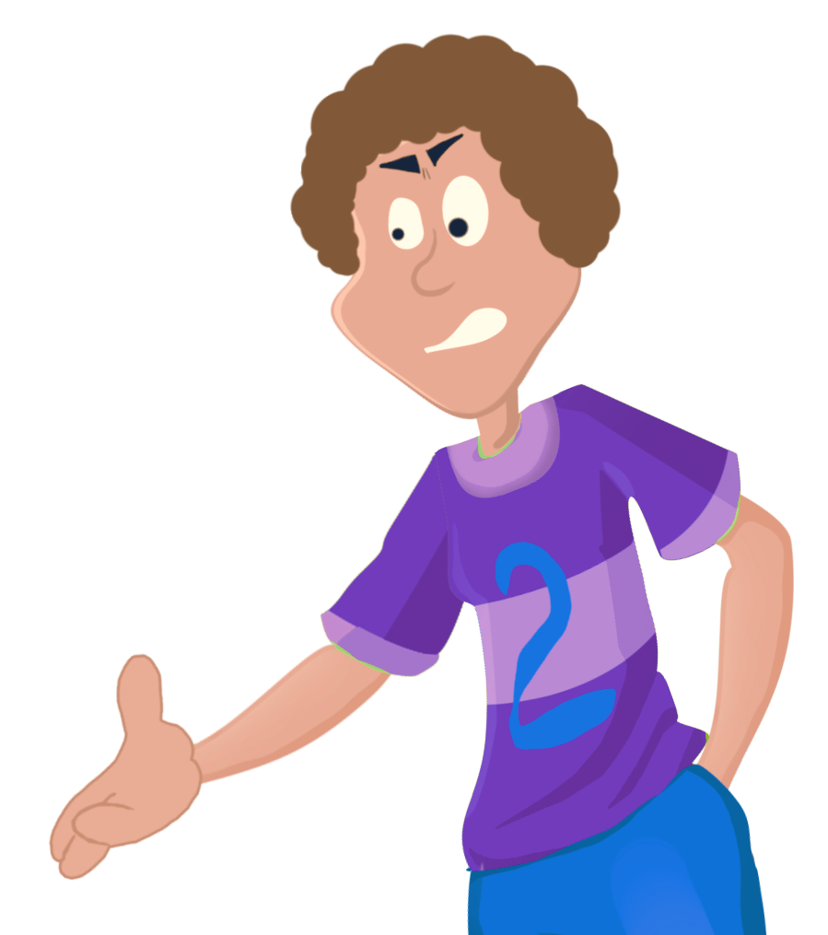
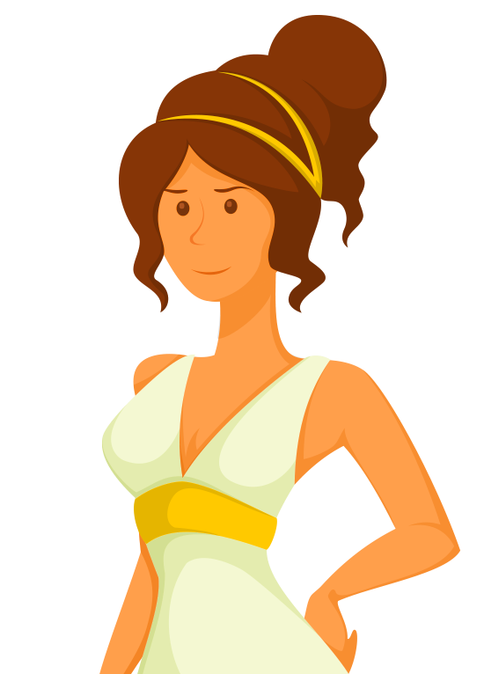
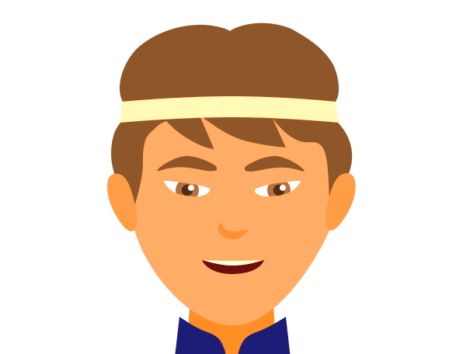
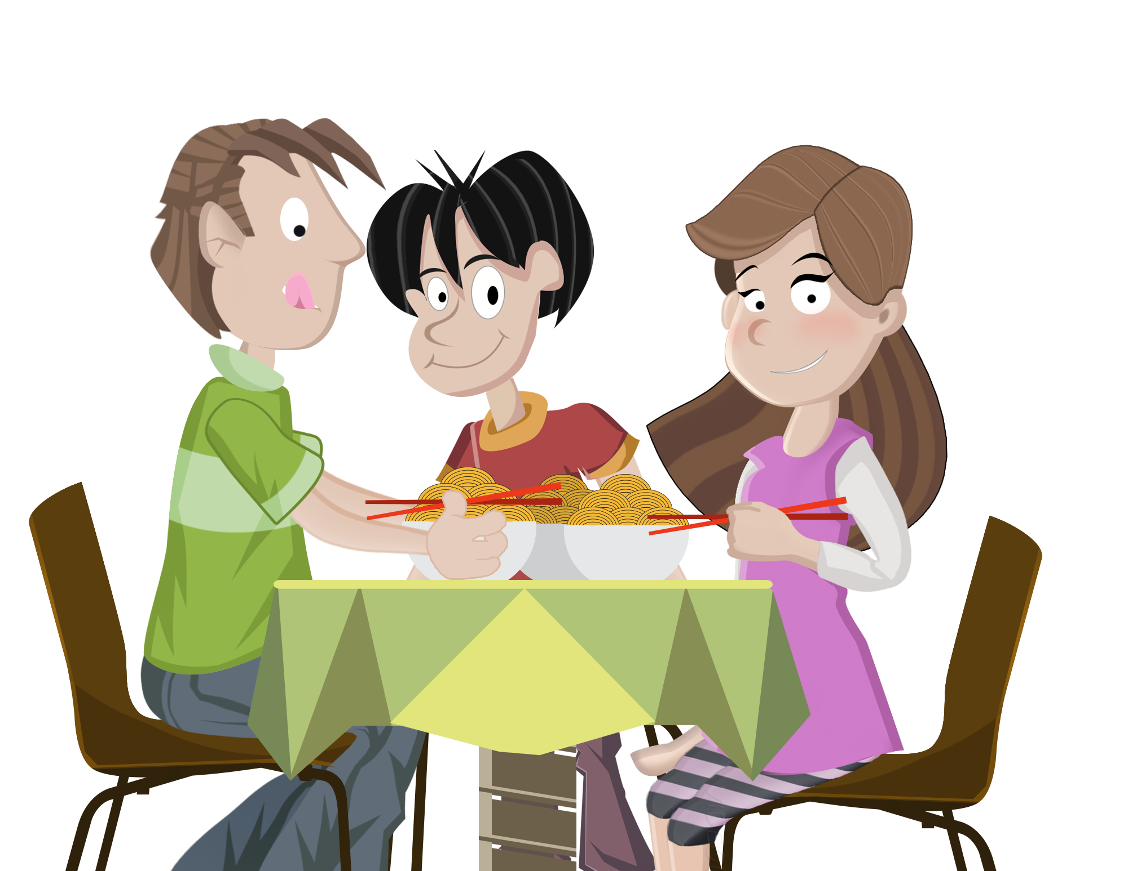
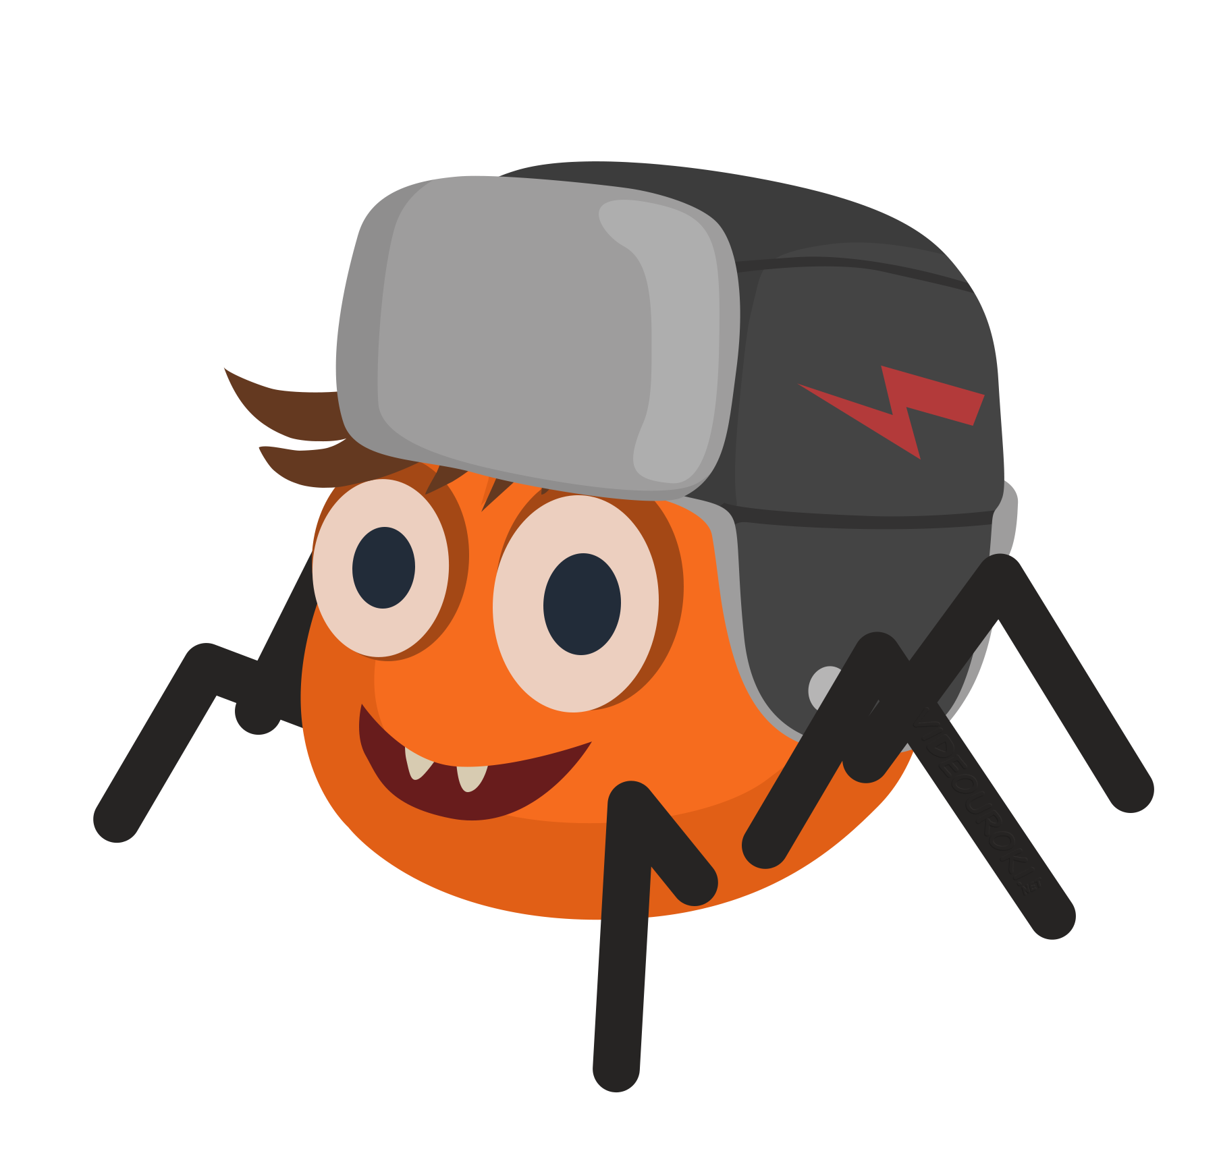
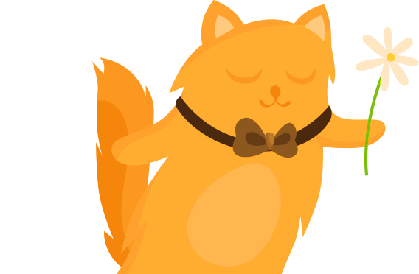
Tall
Fair hair
Short
Look at the pictures and name the new words from the lesson
Sporty
Slim
Dark hair
Friendly
Funny
Kind

Slide 10
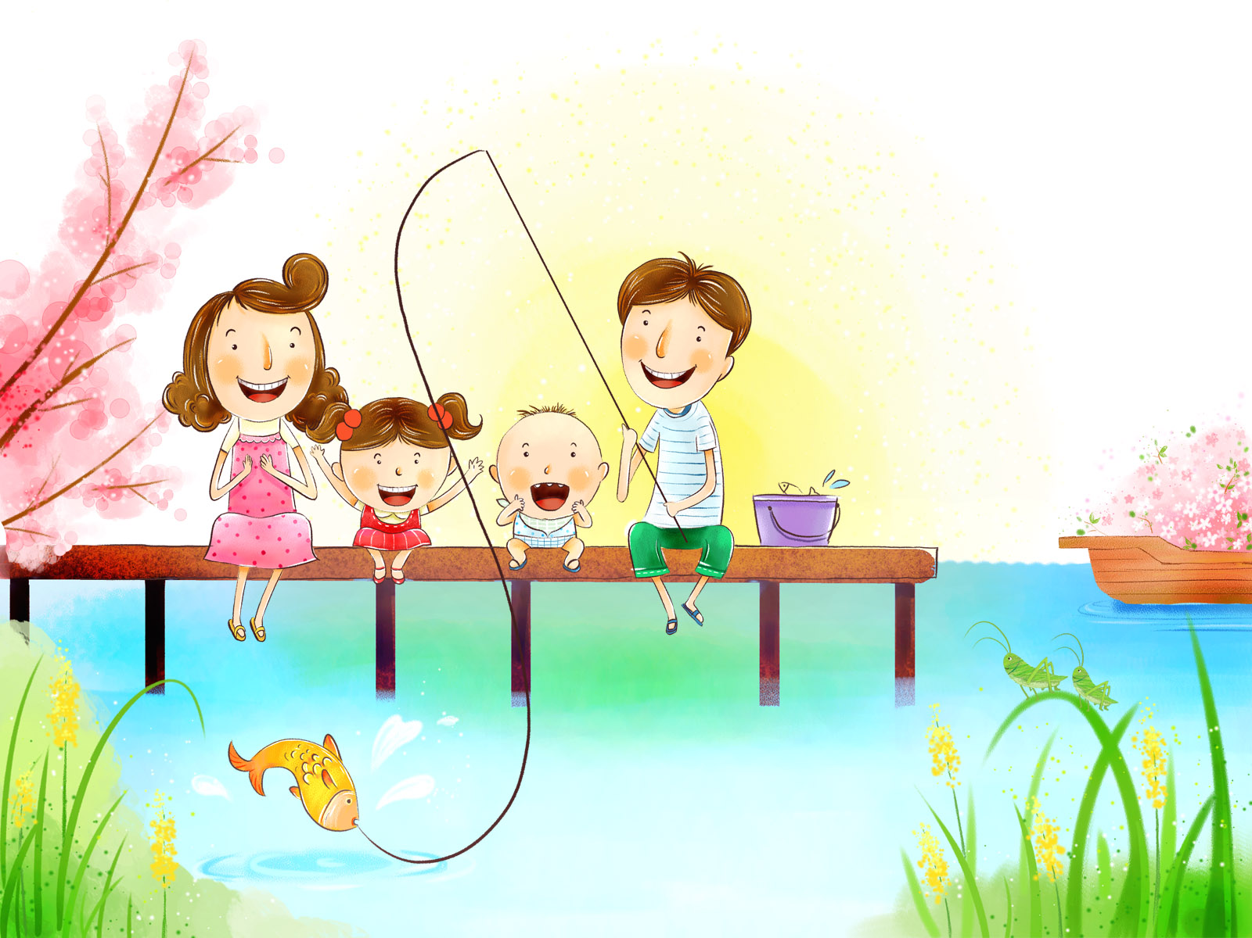
One big happy family!

Slide 11
no
yes

Slide 12



Homework

Slide 13
Now I know ….
Now I can …
It’s difficult …

Slide 14
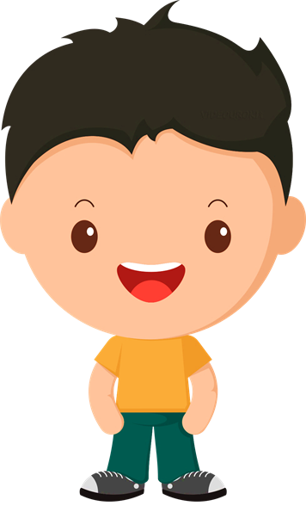
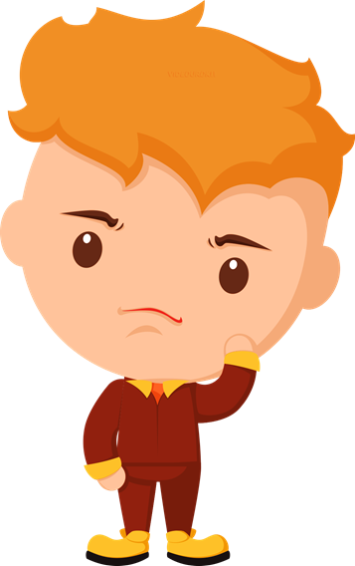
Do you like our lesson?
great
I like the lesson! It is interesting
funny
super
dull
I don’t like the lesson! It is boring
difficult

Slide 15
Thank you!

